Slide 1
DoIP Investigation
Author: Hua Van Thong

Slide 2
Agenda
Introduction
DoIP Basis
Simple setup on CANoe
Our DoIP library.

Slide 3
Introduction

Slide 4
Introduction to DoIP Protocol
The world is getting more connected as more and more devices connect to the internet.
An upcoming trend in the automotive industry is to enable remote access to vehicles for a flexible interface between the diagnostic engineer and vehicle ECU.
As a result, new communication protocols for remote diagnostics of complex systems, such as cars, have been developed. DoIP is one of the most essential of these protocols.
Important: To understand background of DoIP protocol. Refer: https://elearning.vector.com/mod/page/view.php?id=167

Slide 5
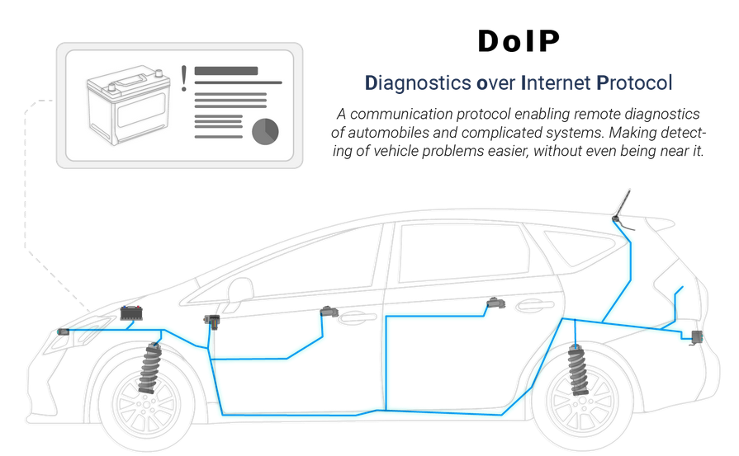
What is DoIP?
DoIP is an important diagnostic protocol that allows you to retrieve diagnostics information from your vehicle's onboard computer system through the internet.

Slide 6
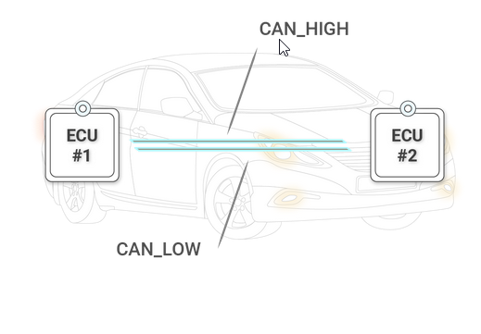
Background
Traditionally testing on ECU:
It only test at local machine.
It can flash ECUs through Ethernet.
Requirements for DoIP protocol:
A requirement for DoIP is the support of UDP and TCP.
UDP is used for transmission of status or configuration information.
A TCP connection, on the other hand, enables transmission of actual diagnostic packets via a fixed communication channel.
OBD

Slide 7
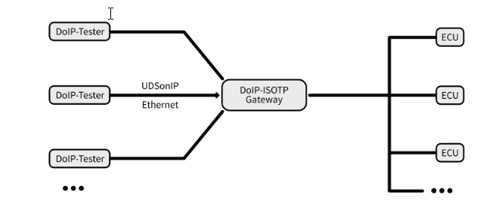
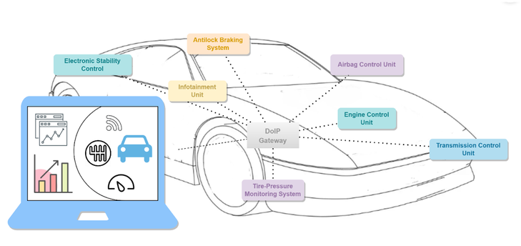
DoIP method
Tester
DoIP Gateway
With DoIP, tester can remote access to ECU through internet.
Requests of the tester are forwarded to internal networks so that a desired ECU can receive and process them. As soon as a response from the requested ECU is available, the gateway routes this back to the tester.
a desired ECU

Slide 8
DoIP method
Tester
PC Server
With DoIP, tester can remote access to ECU through internet.
Or you can access to the target vehicle in the network.
a desired ECU

Slide 9
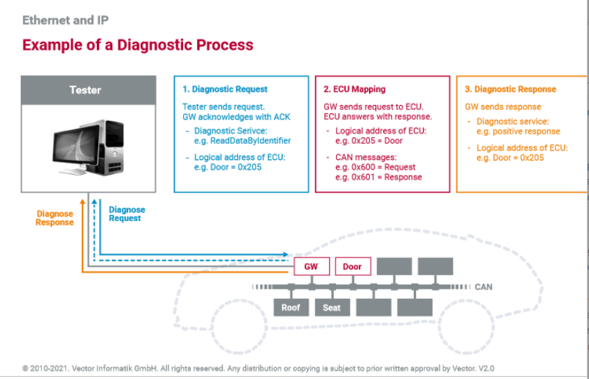
DoIP method

Slide 10
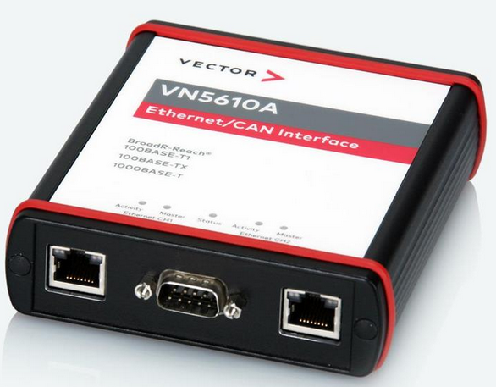
Requirements
Following model before, we need to have:
CANoe software to simulate DoIP ECU on Network.
The Vector VN5610A device attached license to activate CANoe software, then we can start simulation.
Use DoIP Client to interact on DoIP ECU simulation, after that, we can execute on the real device.

Slide 11
DoIP Basis

Slide 12
DoIP Basis
To getting started with DoIP Basis on CANoe, there are some benefits when using CANoe software:
CANoe can simulate all components on networks.
CANoe can create a real hardware for testing and simulate other components.
You can use CANoe to test and control communication between ECUs through the DoIP protocol. This helps you identify errors and work with testing and diagnostic functions.
More details about CANoe: https://www.youtube.com/watch?v=vWfvNN2Vj_0

Slide 13
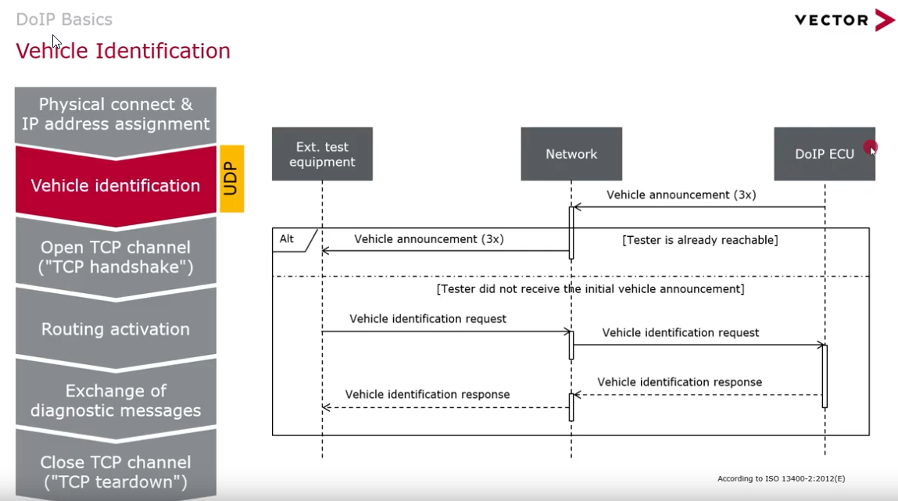
A Typical Communucation Sequence
To identify the vehicle behind DoIP ECUs. There are 2 ways to do it:
When the ECU is powered up, it will send three times the vehicle announcement messages; then depending on the network status, it will be forwarded to the tester.
If tester not receive, tester also send a vehicle identification request to DoIP ECU.
Whole communication sequence is performed using the UDP protocol

Slide 14
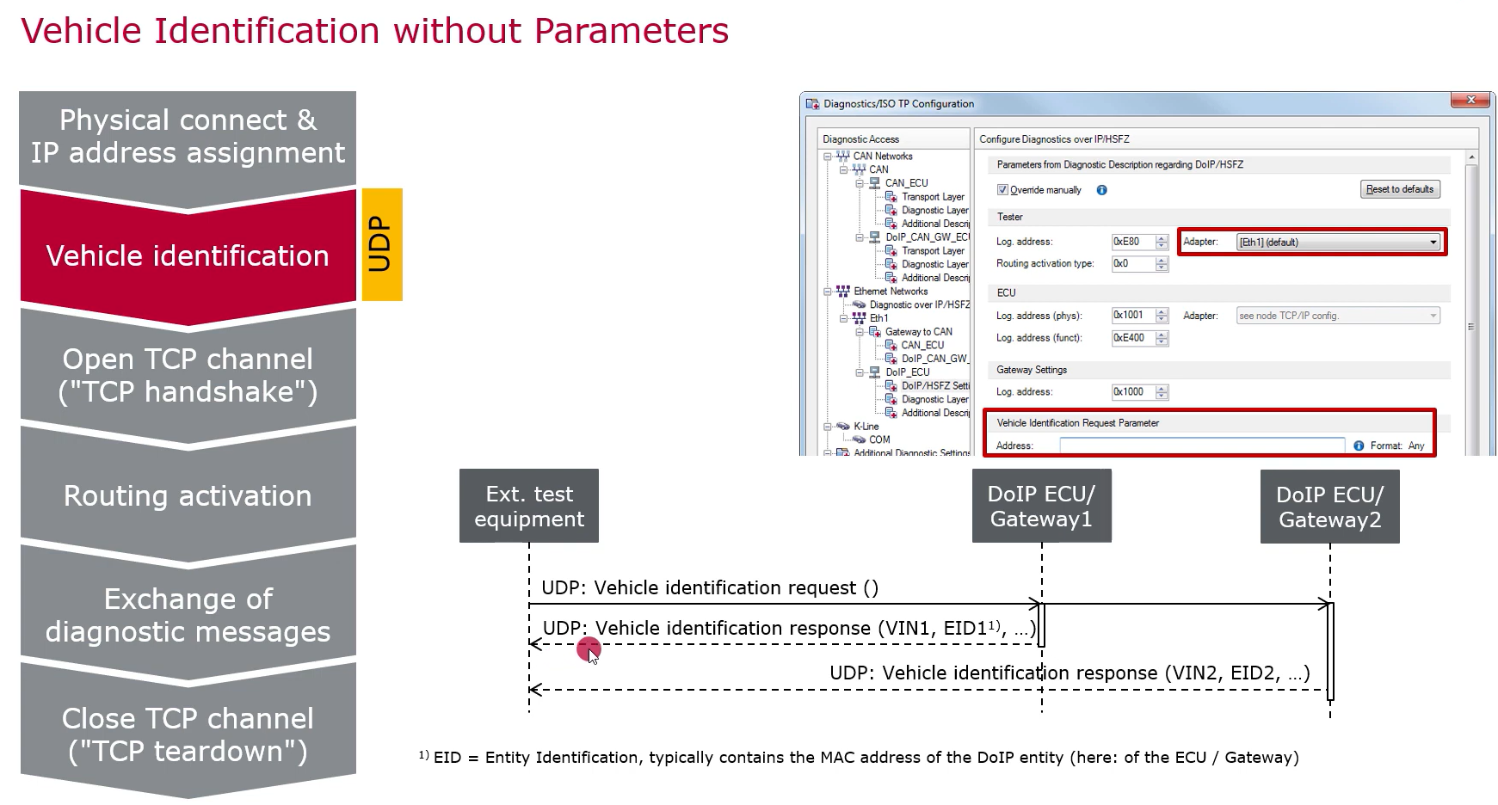
A Typical Communucation Sequence
Basically, if Vehicle identification request() can be sent without parameters, it will ask the network who’s there.
Then, all vehicles in the network which will receive this request.
They will respond with their vehicle identification number through Vehicle identification response() message

Slide 15
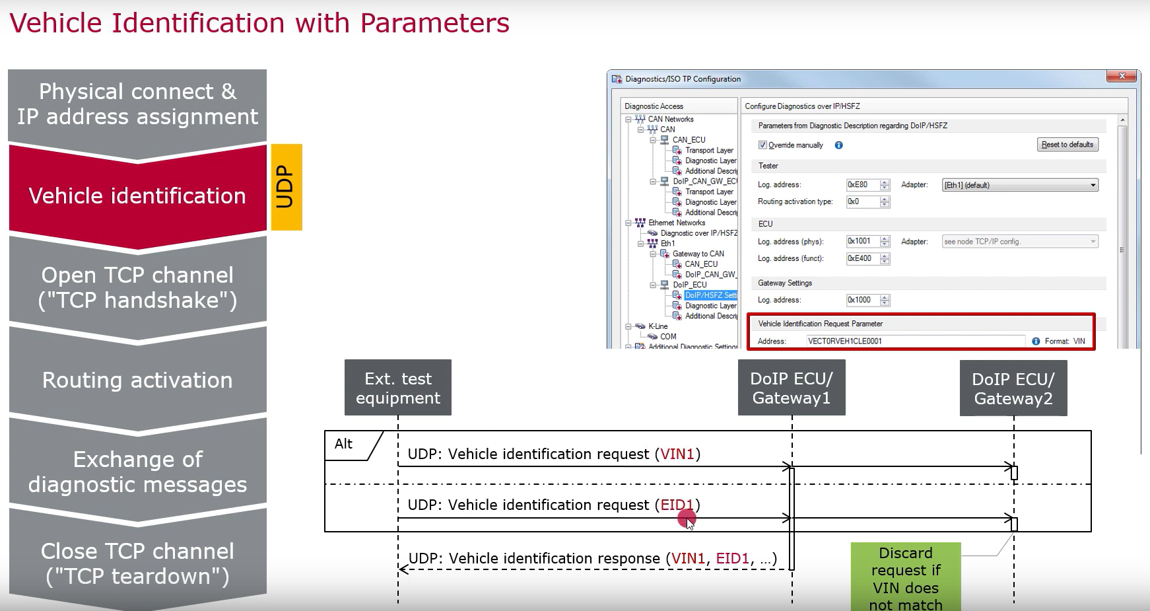
A Typical Communucation Sequence
Beside that, we also send the vehicle identification request with VIN, EID1 parameter to identify the specific vehicle in the network.
Note:
If there are many Tester client, we can use Tester Logical Address to identify Tester
If there are many ECUs, we can use ECU Logical Address to identify ECUs.
If there are many vehicle, we can use Vehicle Identification Request to identify the expected vehicle.

Slide 16
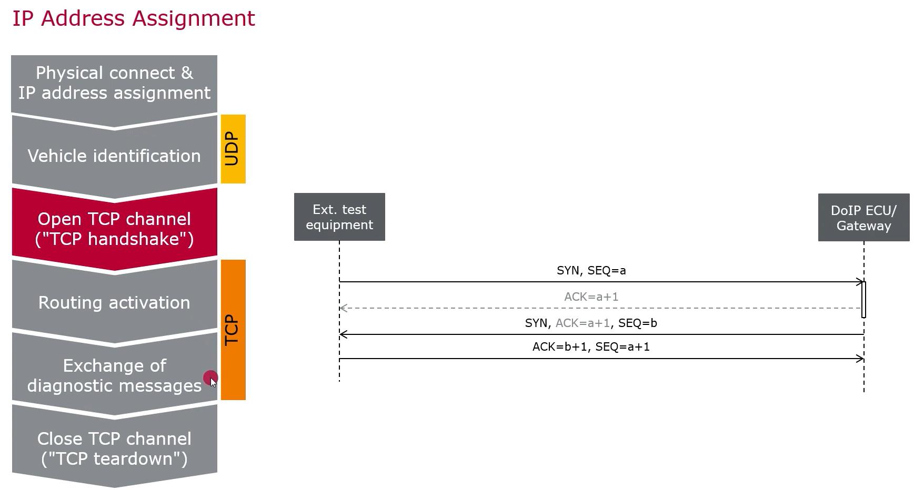
A Typical Communucation Sequence
After identifying the target device for diagnostics, it proceeds to the next step, which involves using the TCP transport protocol:
The tester opens the TCP channel, which is also known as a TCP handshake.

Slide 17
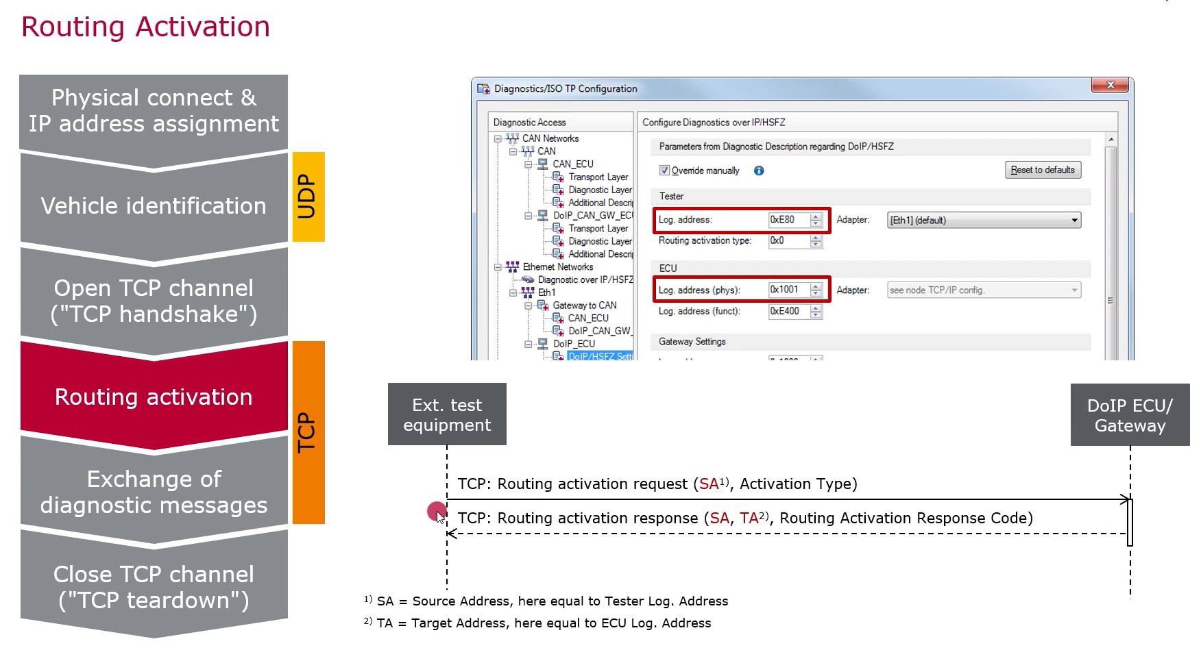
A Typical Communucation Sequence
After TCP connection set up, we can activate the communication with the target ECU behind the gateway.
Routing activation request is sent by tester to the ECU.
The ECU will response if the routing was successfully.
If the routing activation request success, we can activate the target ECU behind the gateway.
Note:
Please ensure that the correct information for the logical address of the ECU and the logical address of the tester is provided.

Slide 18
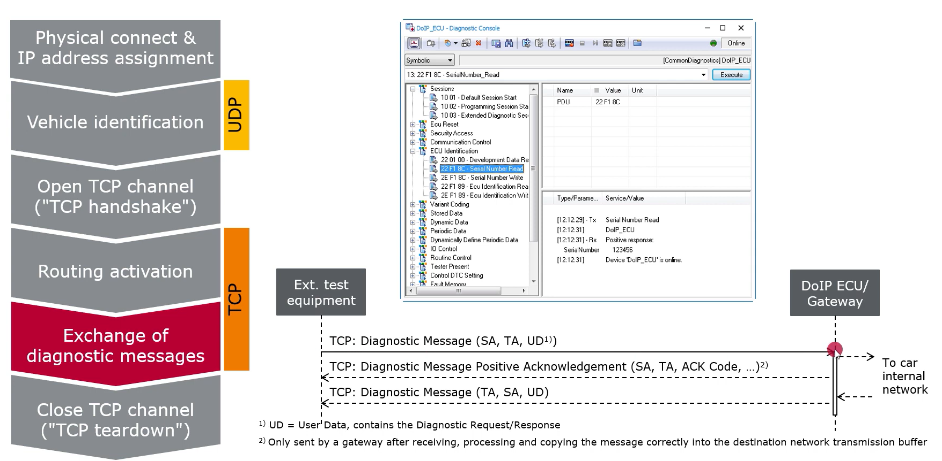
A Typical Communucation Sequence
After a successful connection between the tester and the ECU, we can start exchange of diagnostic message.
We can send any messages supported by CANoe.
Note:
To send message, double click on SerialNumberRead, it can send message immediately.

Slide 19
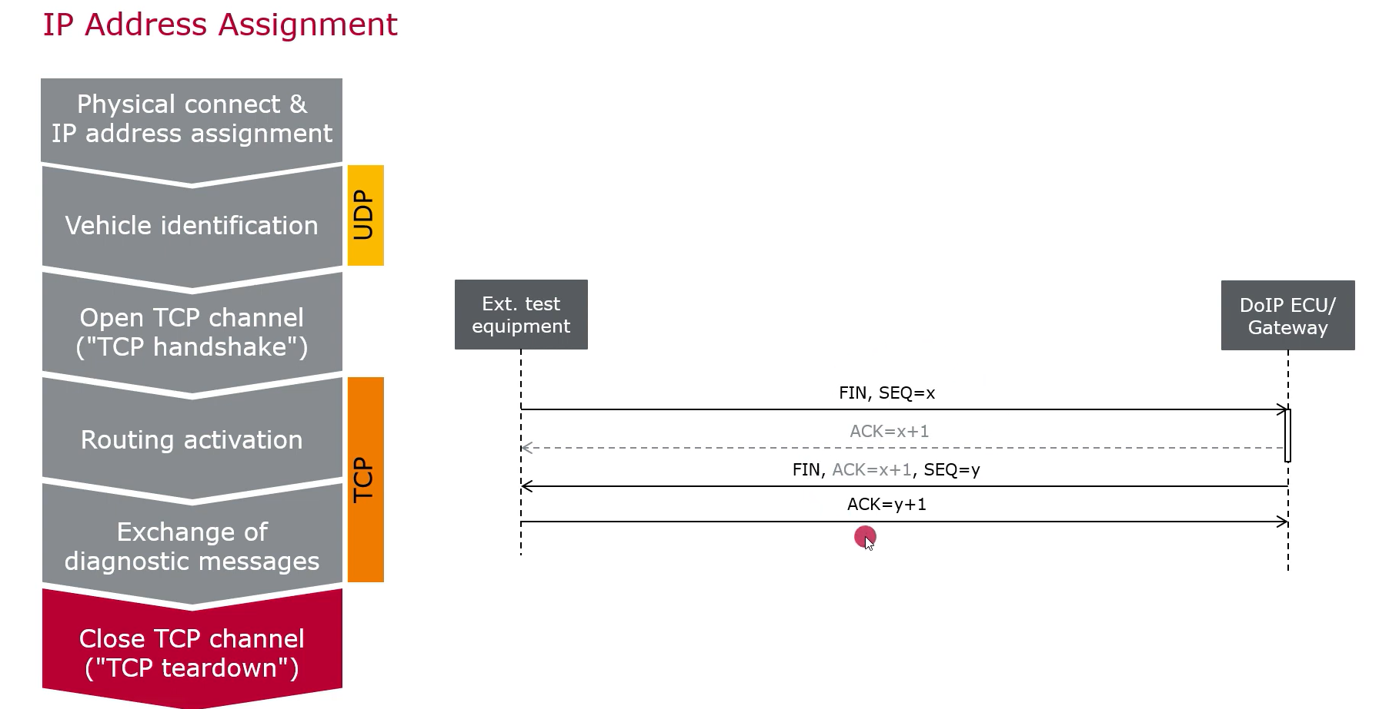
A Typical Communucation Sequence
Finally, we will close TCP connection channel.

Slide 20
Simple Setup on Canoe

Slide 21
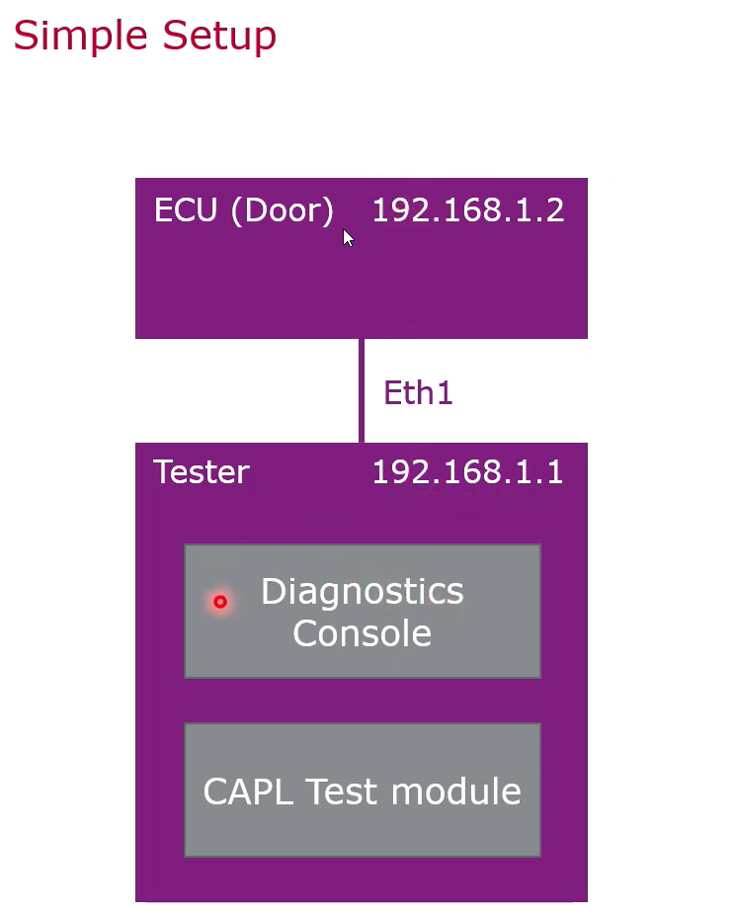
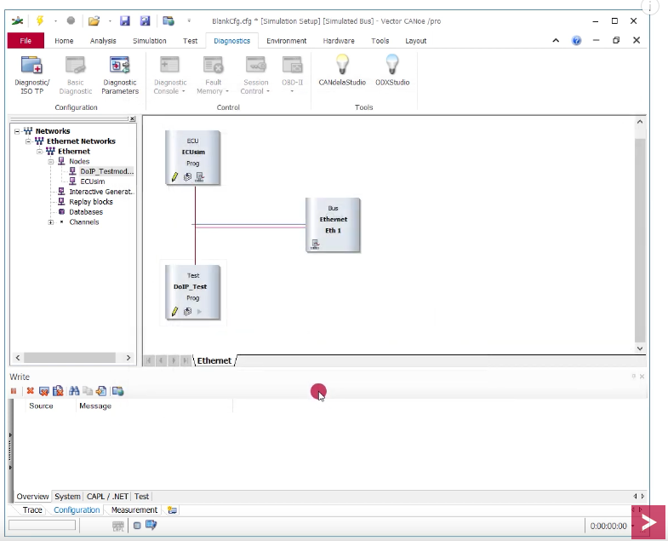
Simple set up diagnostic DoIP for ECU
Prepare simulation for testing:
ECU components.
DoIP components.

Slide 22
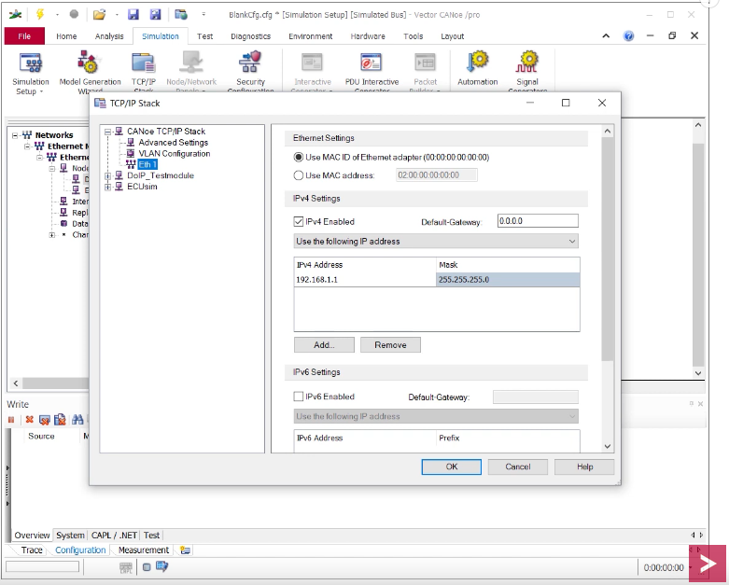
Simple set up diagnostic DoIP for ECU
CANoe TCP/IP Stack is a global network.
DoIP_Testermodule is a client tester.
ECUsim is a ECU simulation

Slide 23
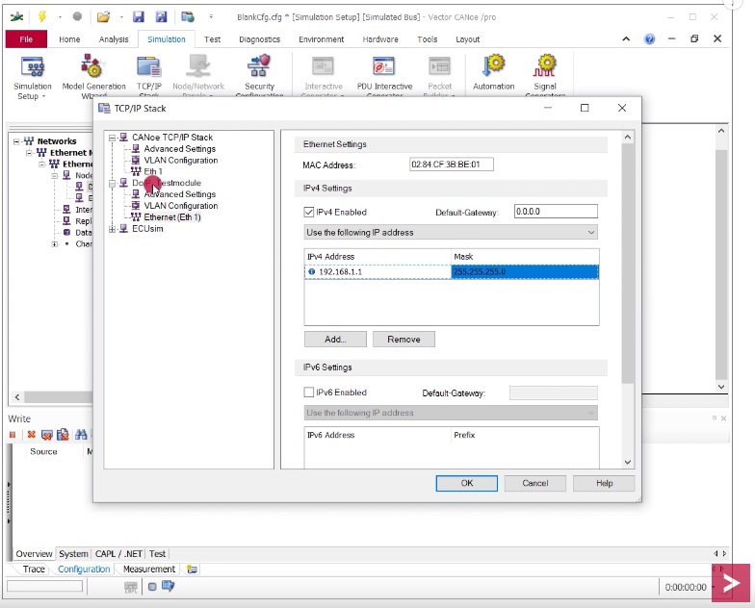
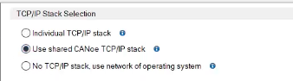
Simple set up diagnostic DoIP for ECU
CANoe TCP/IP Stack is a global network. => 192.168.1.1
Tester need to set up the Diagnostic Console as the same as global network. => 192.168.1.1
To avoid the message error, please set to option: “Use shared CANoe TCP/IP Stack”

Slide 24
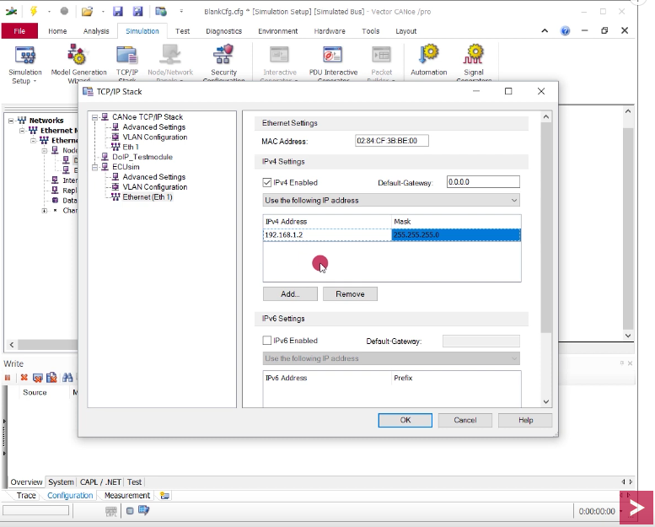
Simple set up diagnostic DoIP for ECU
Set up network on ECUsim is 192.168.1.2

Slide 25
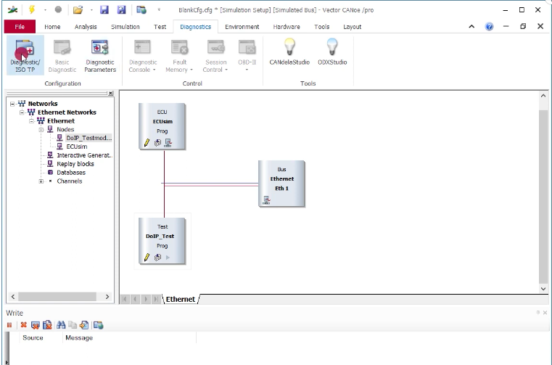
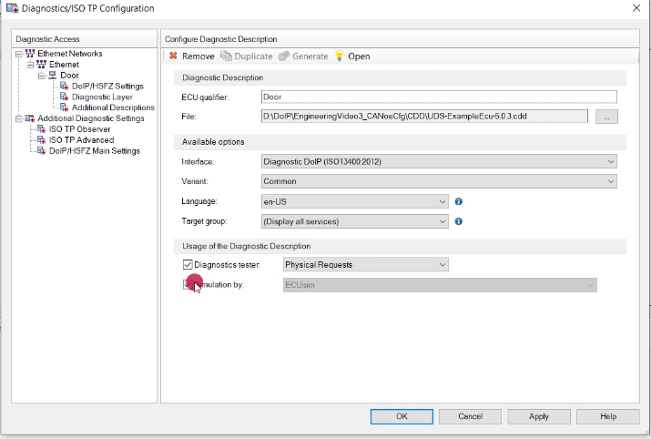
Simple set up diagnostic DoIP for ECU
Set up diagnostic configuration
Then start diagnostic by click Start Measurement

Slide 26
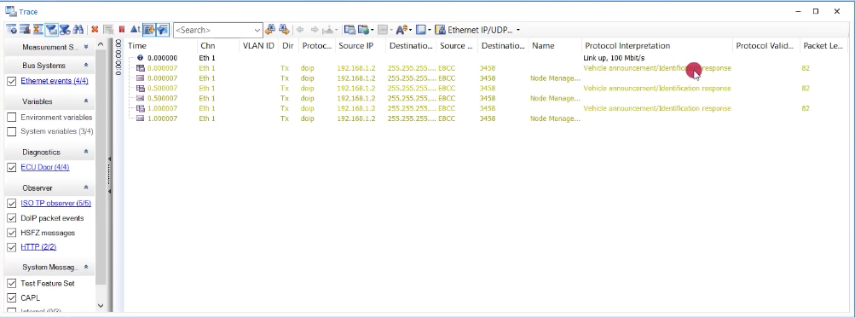
Simple set up diagnostic DoIP for ECU
Output on Trace windows
After start measurement, we can see the vehicle announcement identification from DoIP ECU simulation.

Slide 27
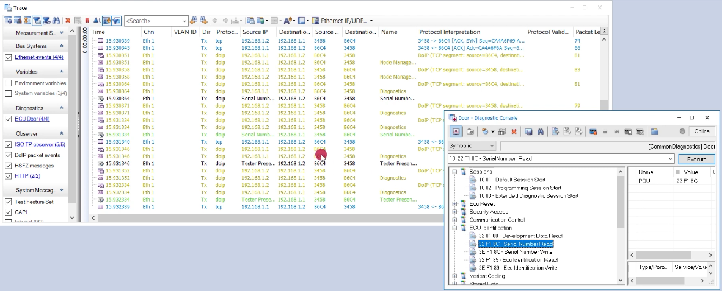
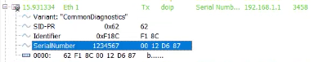
Simple set up diagnostic DoIP for ECU
Output on Trace windows when send the expected message to target ECU.
Step 1: Send SerialNumberRead
Step 2: Receive result from ECU

Slide 28
Our DoIP library

Slide 29
Context
Currently, we have 3 libraries which we need to consider:
DoIP library in PDT team, it’s already worked, and we can see outputs.
DoIP library in Indian team, it’s already done, however it still not apply to PBT team.
DoIP Client library on pipy

Slide 30
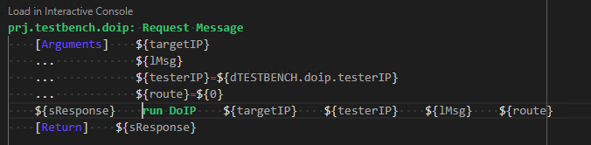
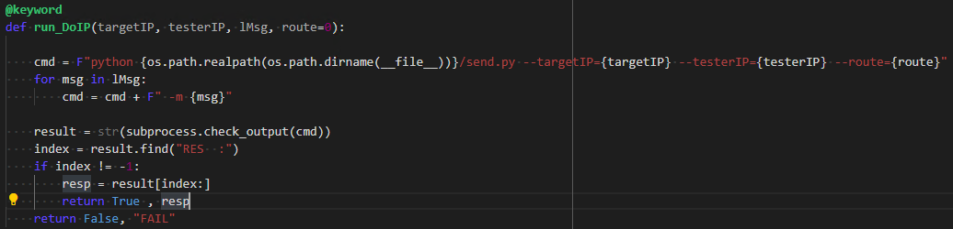
DoIP Robot Keyword in PDT team
Robot Keyword – run DoIP
DoIP is working in PBT team provides keywords:
run DoIP
…..
Implementation for run DoIP

Slide 31
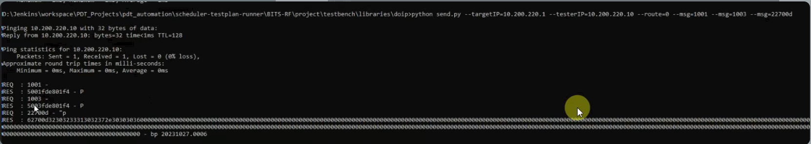
DoIP Robot Keyword in PDT team
Output from terminal:
The necessary parameters:
TargetIP: IP of target device.
TesterIP: IP of target tester.
We can see the diagnostic message can be sent successfully on the above terminal.

Slide 32
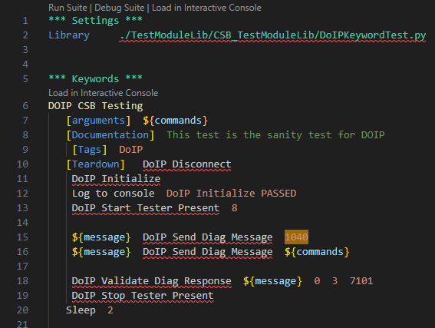
DoIP Robot Keyword in Indian
Robot Keyword
DoIP Indian provides keywords:
DoIP Initialize
DoIP Send Diag Message
DoIP Validate Diag Response
DoIP Start Tester Present
DoIP Stop Tester Present

Slide 33
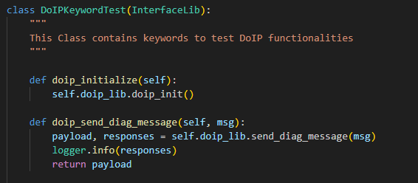
DoIP Robot Keyword in Indian
Implementation for keyword
DoIP Indian provides keywords:
DoIP Initialize
DoIP Send Diag Message
DoIP Validate Diag Response
DoIP Start Tester Present
DoIP Stop Tester Present

Slide 34
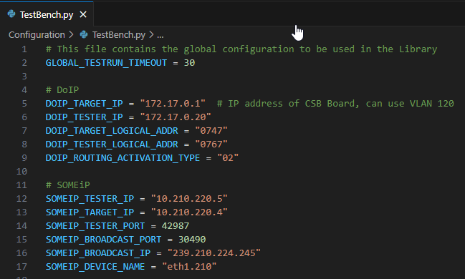
DoIP Robot Keyword in Indian
Testbench.py info configuration
The necessary parameters:
DOIP_TARGET_IP: IP of target device.
DOIP_TESTER_IP: IP of target tester.
DOIP_TARGET_LOGICAL_ADDR: IP of target ECU.
DOIP_TESTER_LOGICAL_ADDR: IP of target tester.

Slide 35
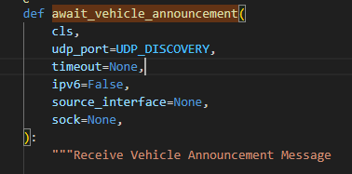
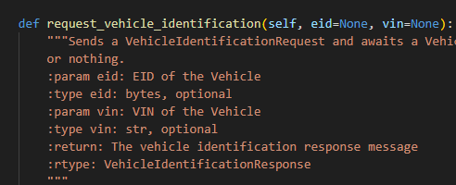
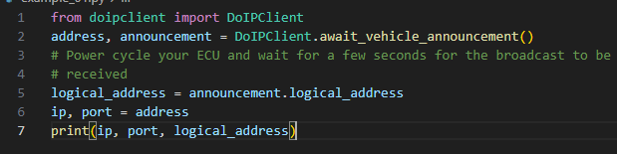
DoIP Client for pypi
As my investigation, DoIP Client for pypi have the method implementation following sequence diagram.
DoIP Client receive the vehicle announcement messages from application.

Slide 36
Reference:
DoIP concepts: https://www.autopi.io/blog/diagnostics-over-internet-protocol-explained/
DoIP ECU: https://pi3g.com/wp-content/uploads/2021/10/doip-isotp-gw.pdf
DoIP in Canoe: https://www.youtube.com/watch?v=mjcG_n0ICDQ
Autosar DoIP specification: https://www.autosar.org/fileadmin/standards/R4-4-0/CP/AUTOSAR_SWS_DiagnosticOverIP.pdf
CANoe Demo with trial key: https://www.vector.com/int/en/support-downloads/download-center/#product=%5B%22115%22%5D&downloadType=%5B%22demos%22%5D&tab=1&pageSize=15&sort=date&order=desc

